Slide 1
Stewarding Ithaca’s Gorges
A Data Science Report on the Gorge Stewards Program
Ming DeMers
9/14/2023

Slide 2
Background
The gorges are beautiful and enjoyed by thousands of people every year
They are deceptively dangerous
The Gorge Stewards Program was established in 2014 to improve safety and enjoyment of the gorges
This project will explore how usage of the Gorges has fluctuated, how violations of gorge rules has decreased

Slide 3
The Data
Sourced from the Gorge Stewards Program, courtesy of the Cornell Botanic Gardens and Cornell
8 Summers of data
Data points include gorge usage, violations, weather and more.
Violations include swimming the gorges, trespassing, illicit substances, etc
Cleaning involves many steps
Fixing date formats
Removing whitespaces
Refactoring and column realignment
Around 80 data points lost

Slide 4
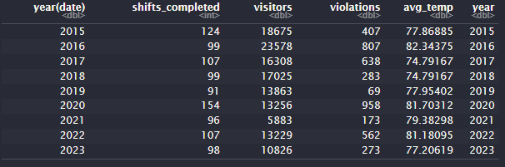
Exploratory Analysis
An overall understanding of the Gorges over its years
Due to format of the data changing, some granular detail is lost.

Slide 5
Exploratory Analysis
Some 14,000 visitors experience the Gorges every year
Around 12 stewards patrol every Summer
Average temperature is a high 70s
Around 100 shifts are completed every year.
Notable are the years 2018, 2019, 2020, and 2021.

Slide 6
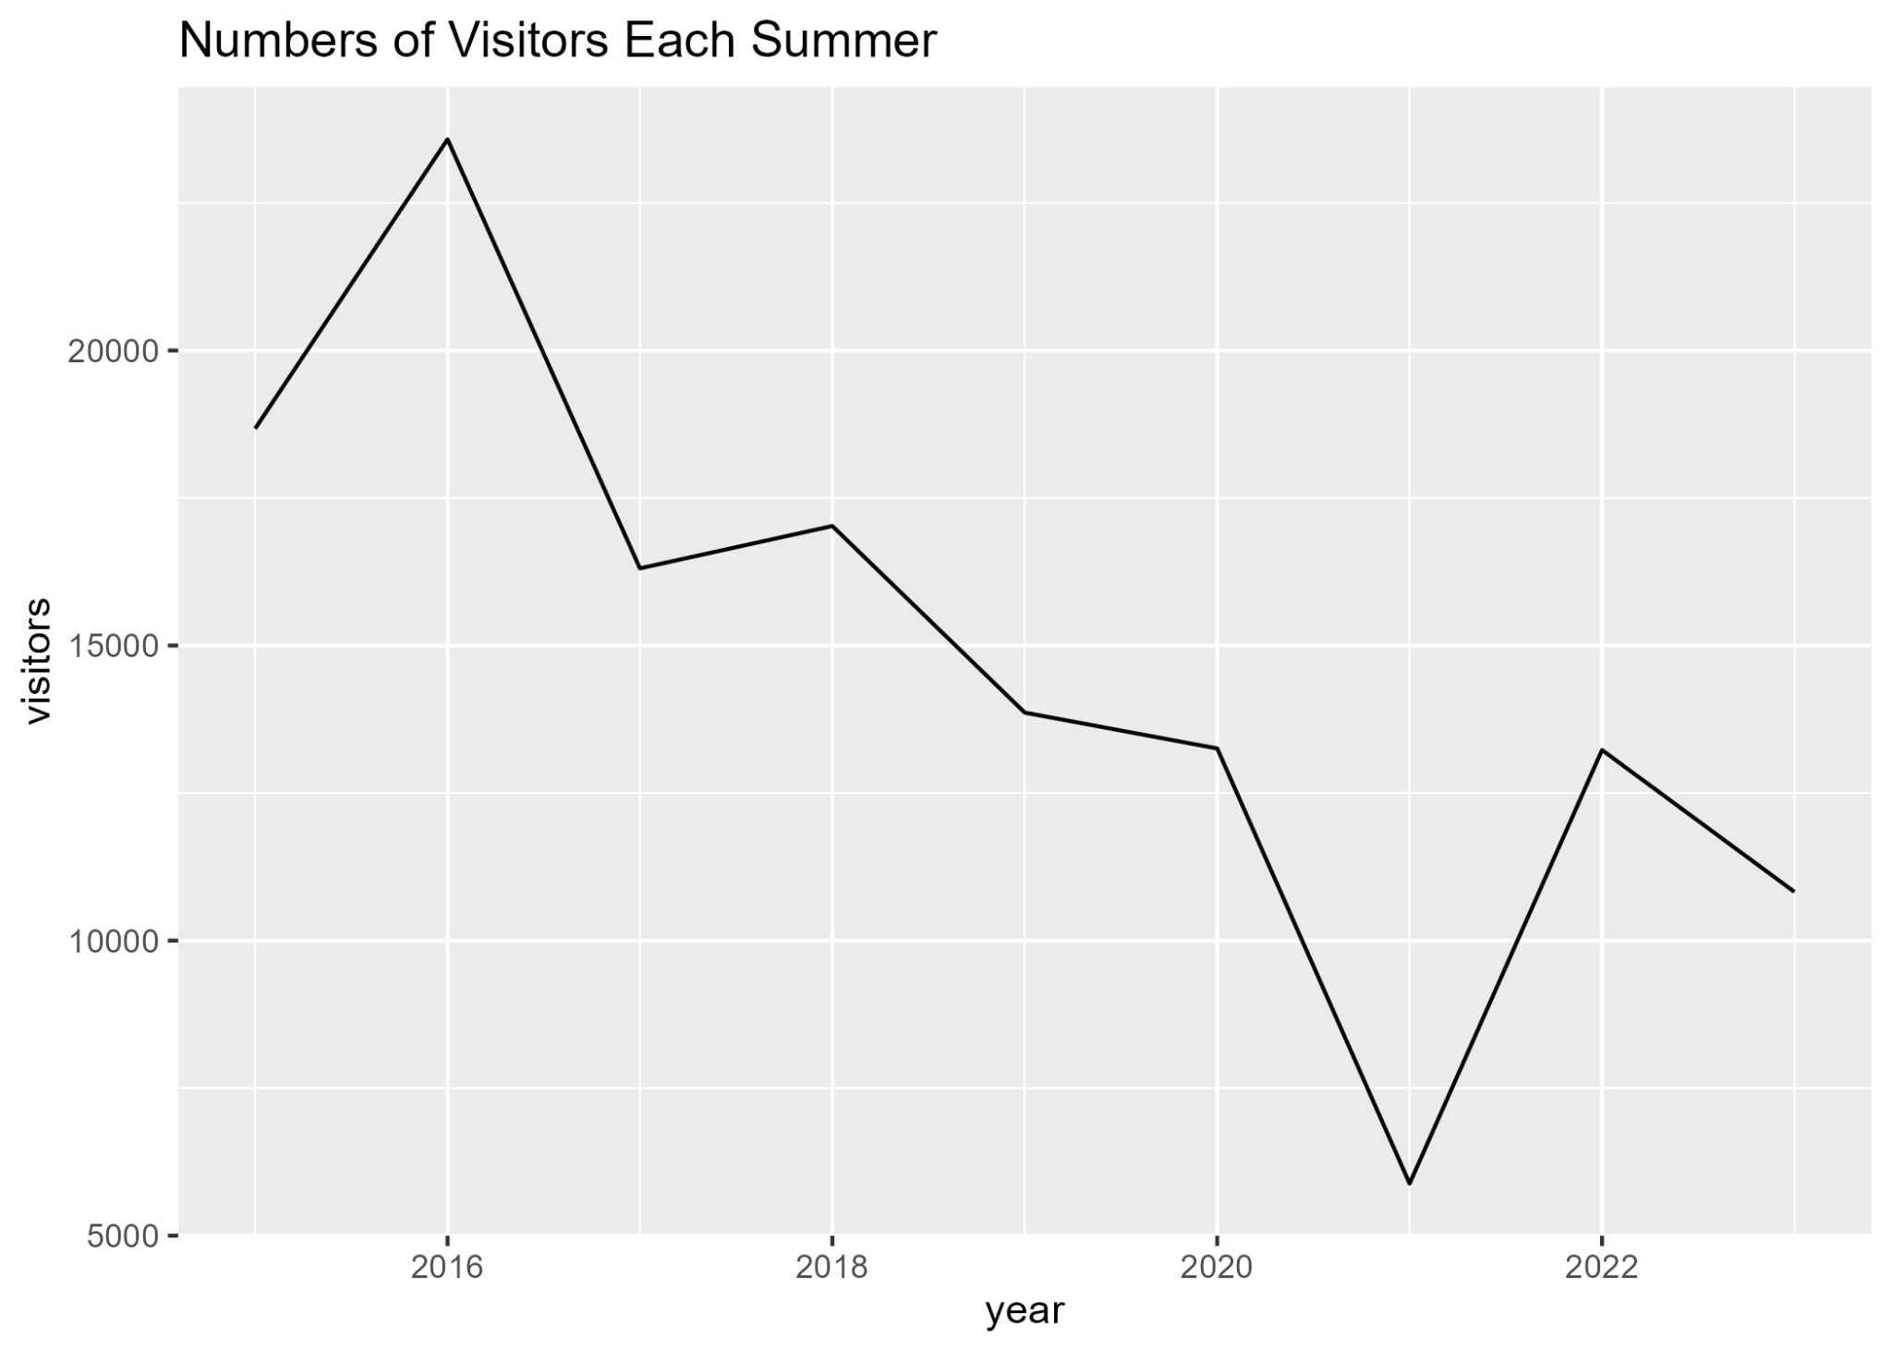

Slide 7
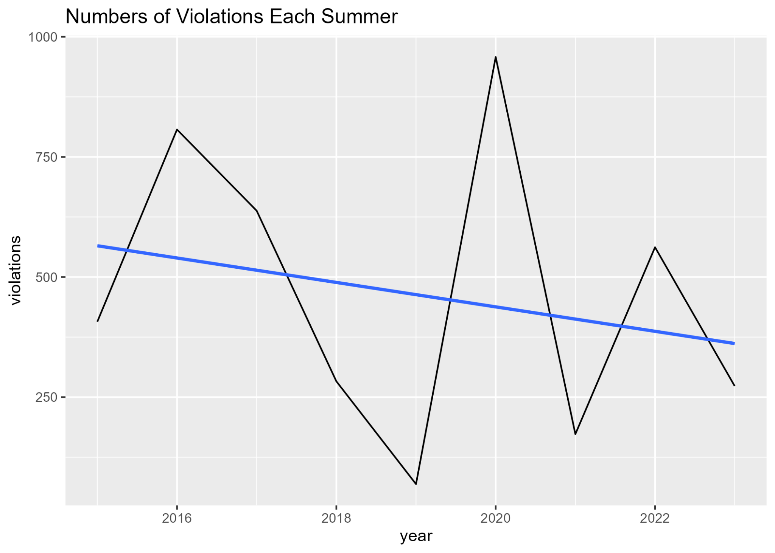

Slide 8
The Gorges in 2022
We now take a look in just the Summer of 2022
This is the most recent and robust Summer

Slide 9
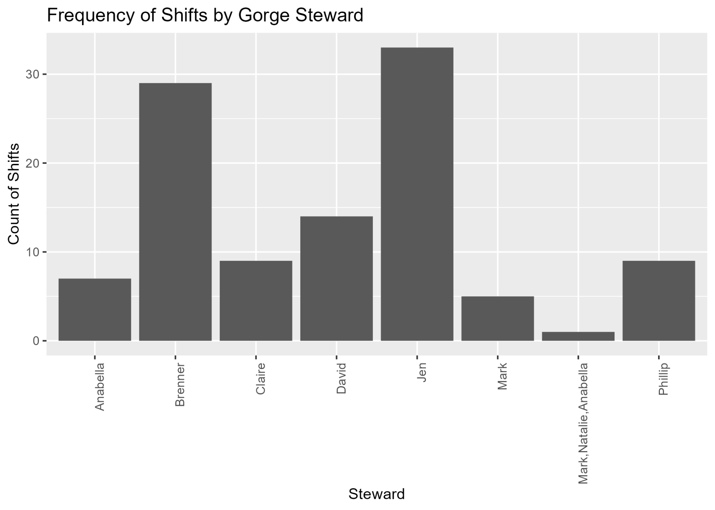

Slide 10
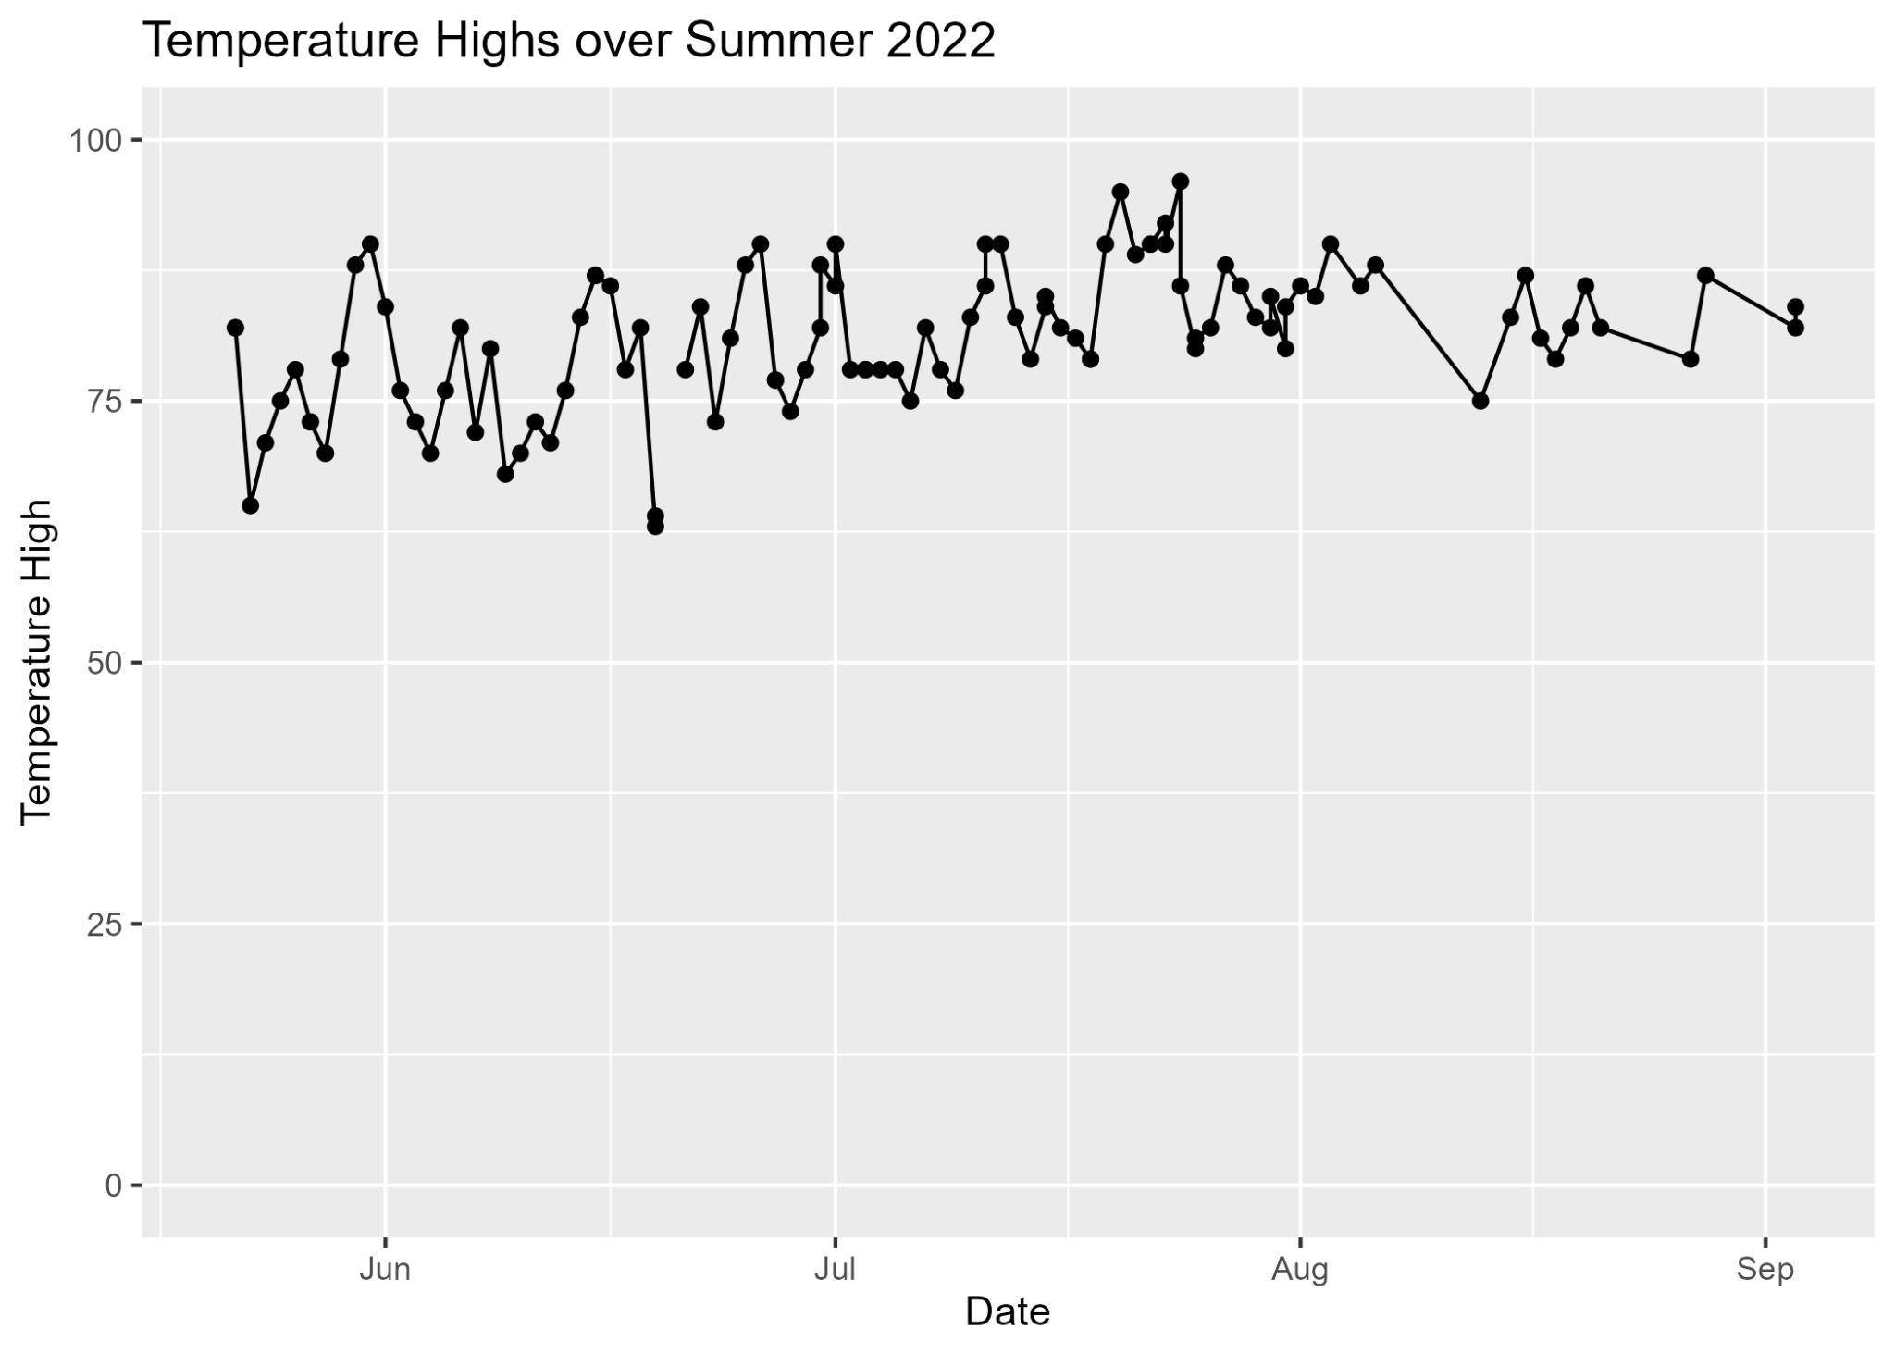

Slide 11
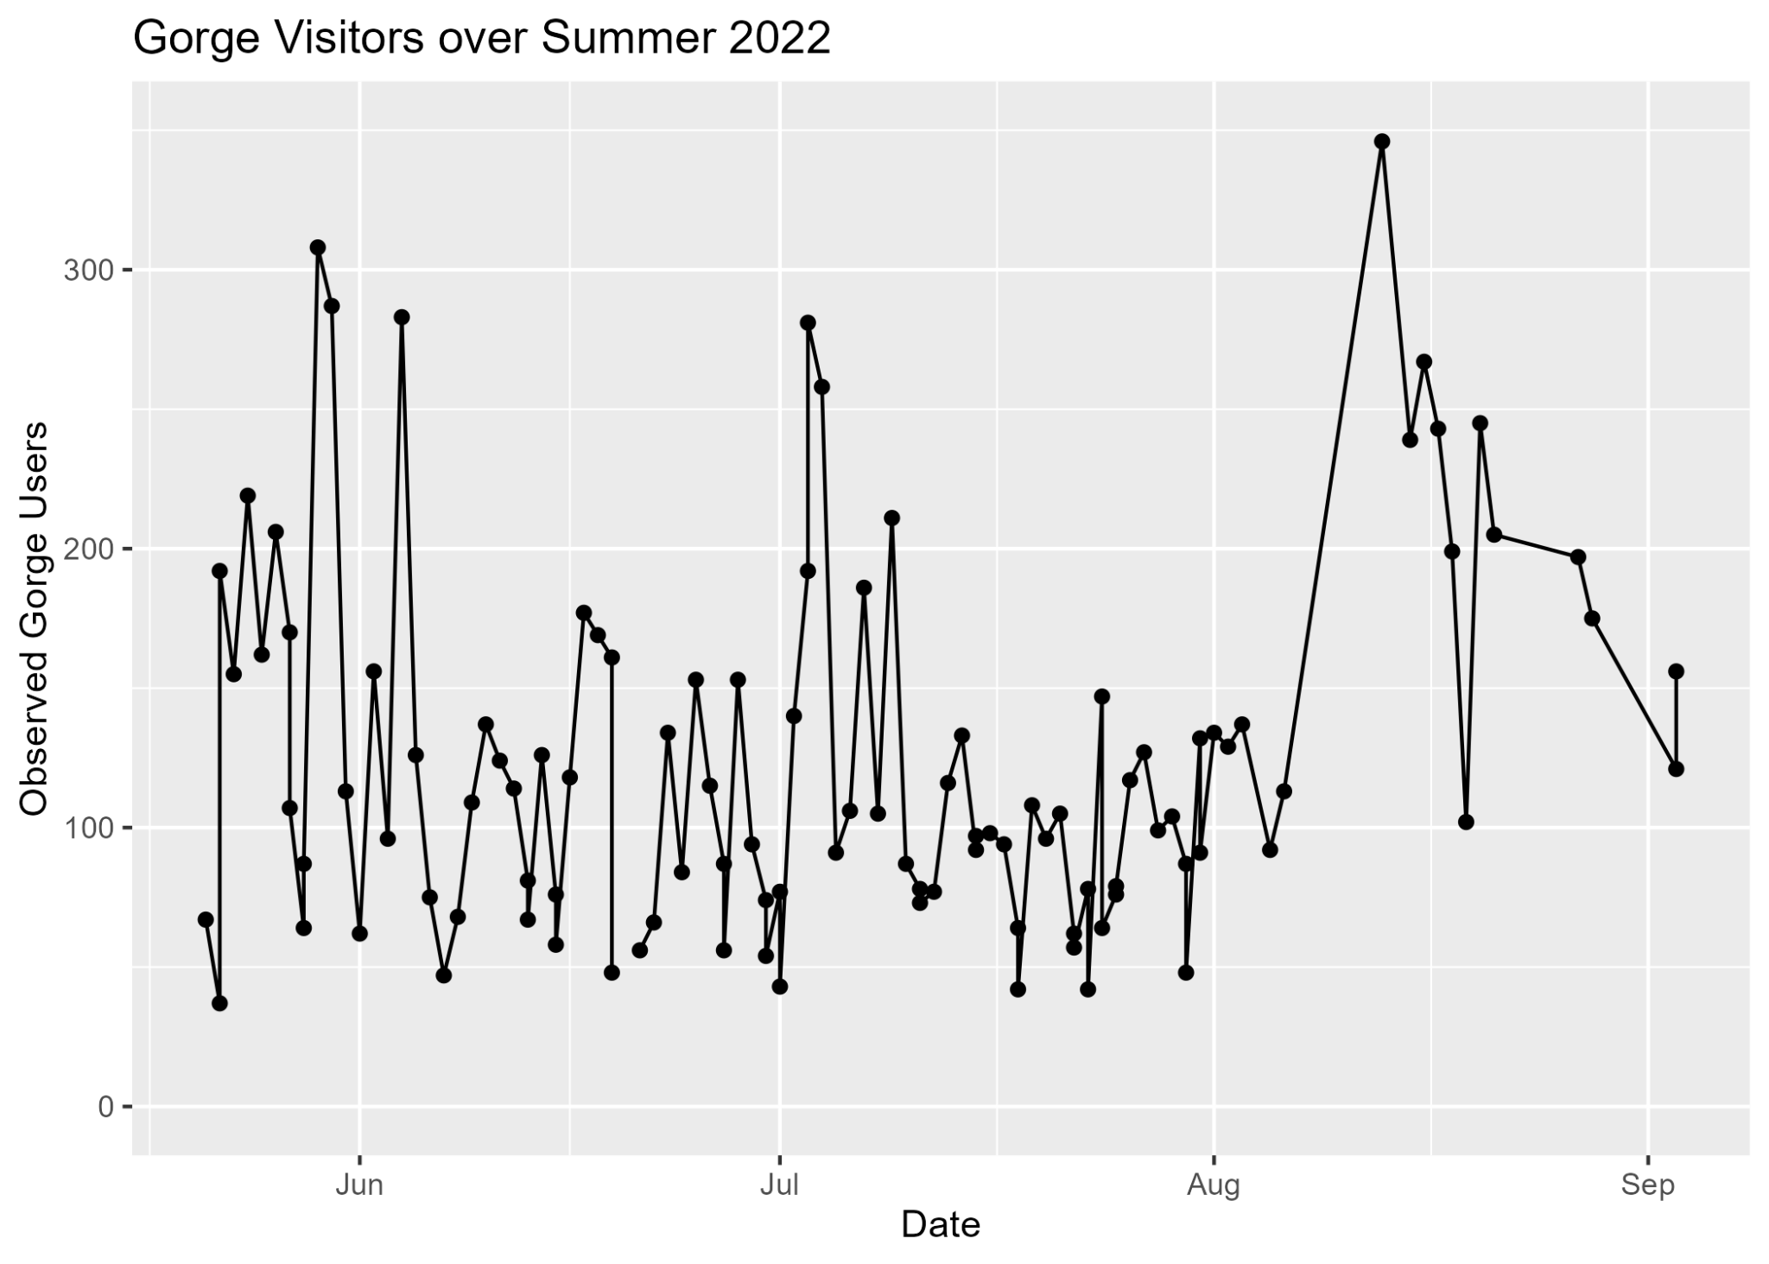

Slide 12
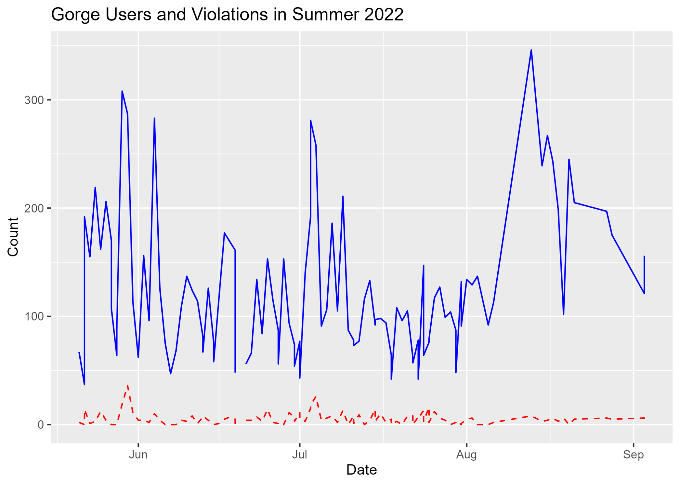

Slide 13
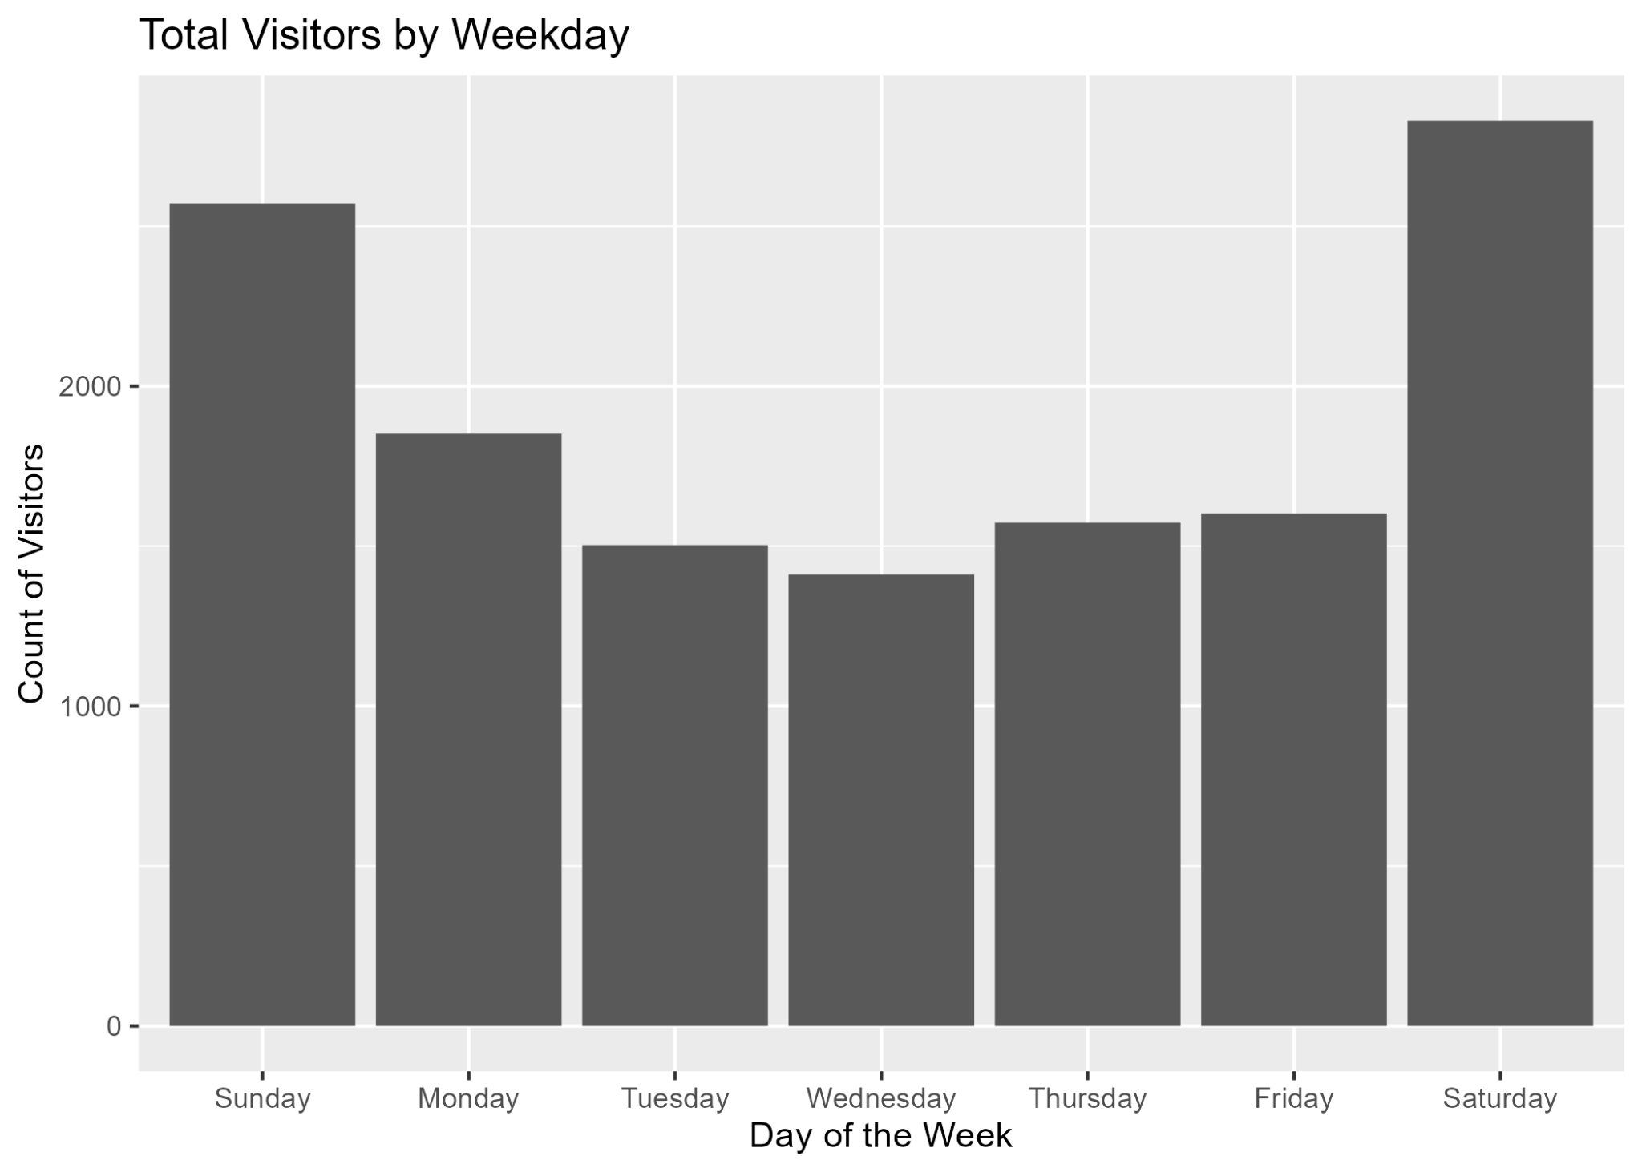

Slide 14
Possible Correlations to Violations
Highest correlations are observed users to violations
In the past four years, they correlate by 0.5134591
Temperature seems to have to no correlation with gorge visitors
< 0.1
High temperature is correlated with violations
In 2023, 0.25
Average 0.18 R^2

Slide 15
Future Work
Text analysis
ML Model training

Slide 16
Conclusion
The most popular times to visit the Gorges are towards the beginning or end of the academic year, and on the Fourth of July.
Overall number of visitors has decreased, while violations have significantly decreased since the inception of the program.
COVID did not seem to have too dramatic of an effect; although 2021 had the lowest visitor count by far
It is also possible that high temperatures cause more violations.
There's more analysis that can be conducted, especially in terms of text analysis and model training.
The data reinforces the success of the Gorge Stewards Program and its positive effect on the Gorges.

